Slide 1
Chapter 6: Integrity Policies
Overview
Requirements
Biba’s models
Clark-Wilson model

Slide 2
Overview
Requirements
  Very different than confidentiality policies
Biba’s model
Clark-Wilson model

Slide 3
Requirements of Policies
Users will not write their own programs, but will use existing production programs and databases.
Programmers will develop and test programs on a non-production system; if they need access to actual data, they will be given production data via a special process, but will use it on their development system.
A special process must be followed to install a program from the development system onto the production system.
The special process in requirement 3 must be controlled and audited.
The managers and auditors must have access to both the system state and the system logs that are generated.

Slide 4
Biba Integrity Model
Set of subjects S, objects O, integrity levels I, relation ≤ ⊆ I × I holding when second dominates first
min: I × I → I returns lesser of integrity levels
i: S ∪ O → I gives integrity level of entity
r: S × O means s ∈ S can read o ∈ O
w, x defined similarly

Slide 5
Intuition for Integrity Levels
The higher the level, the more confidence
  That a program will execute correctly
  That data is accurate and/or reliable
Note relationship between integrity and trustworthiness
Important point: integrity levels are not security levels

Slide 6
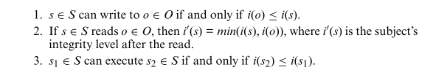
Low Water-mark Policy

Slide 7

Low Water-mark Policy

Slide 8
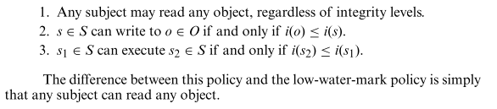
Ring Policy

Slide 9
Biba’s Model
Similar to Bell-LaPadula model
  s ∈ S can read o ∈ O iff i(s) ≤ i(o)
  s ∈ S can write to o ∈ O iff i(o) ≤ i(s)
  s₁ ∈ S can execute s₂ ∈ S iff i(s₂) ≤ i(s₁)
Add compartments and discretionary controls to get full dual of Bell-LaPadula model
Information flow result holds
  Different proof, though
Actually the “strict integrity model” of Biba’s set of models

Slide 10
LOCUS and Biba
Goal: prevent untrusted software from altering data or other software
Approach: make levels of trust explicit
  credibility rating based on estimate of software’s trustworthiness (0 untrusted, n highly trusted)
  trusted file systems contain software with a single credibility level
  Process has risk level or highest credibility level at which process can execute
  Must use run-untrusted command to run software at lower credibility level

Slide 11
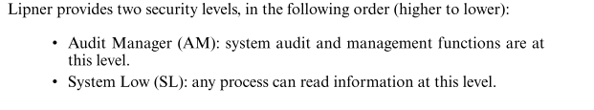
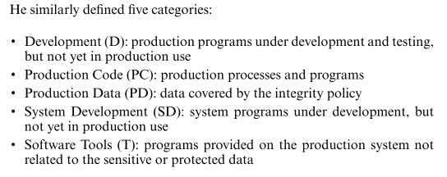
Lipners Integrity Matrix Model

Slide 12
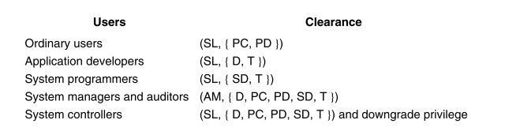
Security Levels for Subjects

Slide 13
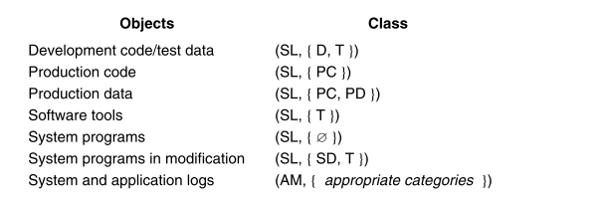
Security Levels for Objects

Slide 14
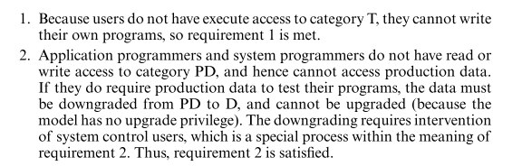
Security Requirements of the Model

Slide 15
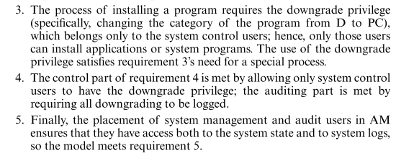
Security Requirements of the Model

Slide 16

Lipner’s Full Matrix Integrity Model

Slide 17
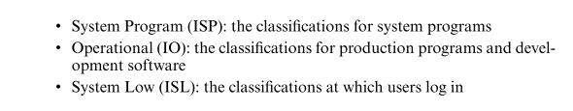

Lipner’s Full Model

Slide 18
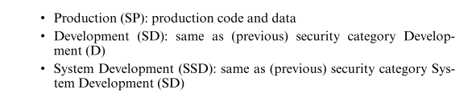

Slide 19
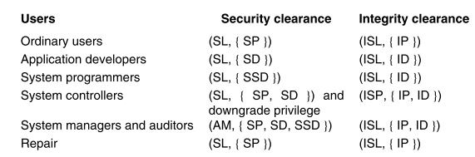
Security and Integrity Levels for Subjects

Slide 20
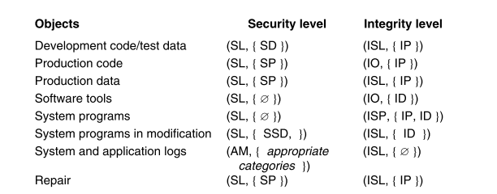
Security and Integrity Levels for Objects

Slide 21


Comparison with Biba

Slide 22
Clark-Wilson Integrity Model
Integrity defined by a set of constraints
  Data in a consistent or valid state when it satisfies these
Example: Bank
  D today’s deposits, W withdrawals, YB yesterday’s balance, TB today’s balance
  Integrity constraint: D + YB –W
Well-formed transaction move system from one consistent state to another
Issue: who examines, certifies transactions done correctly?

Slide 23
Entities
CDIs: constrained data items
  Data subject to integrity controls
UDIs: unconstrained data items
  Data not subject to integrity controls
IVPs: integrity verification procedures
  Procedures that test the CDIs conform to the integrity constraints
TPs: transaction procedures
  Procedures that take the system from one valid state to another

Slide 24
Certification Rules 1 and 2
CR1 When any IVP is run, it must ensure all CDIs are in a valid state
CR2 For some associated set of CDIs, a TP must transform those CDIs in a valid state into a (possibly different) valid state
  Defines relation certified that associates a set of CDIs with a particular TP
  Example: TP balance, CDIs accounts, in bank example

Slide 25
Enforcement Rules 1 and 2
ER1 The system must maintain the certified relations and must ensure that only TPs certified to run on a CDI manipulate that CDI.
ER2 The system must associate a user with each TP and set of CDIs. The TP may access those CDIs on behalf of the associated user. The TP cannot access that CDI on behalf of a user not associated with that TP and CDI.
  System must maintain, enforce certified relation
  System must also restrict access based on user ID (allowed relation)

Slide 26
Users and Rules
CR3 The allowed relations must meet the requirements imposed by the principle of separation of duty.
ER3 The system must authenticate each user attempting to execute a TP
  Type of authentication undefined, and depends on the instantiation
  Authentication not required before use of the system, but is required before manipulation of CDIs (requires using TPs)

Slide 27
Logging
CR4 All TPs must append enough information to reconstruct the operation to an append-only CDI.
  This CDI is the log
  Auditor needs to be able to determine what happened during reviews of transactions

Slide 28
Handling Untrusted Input
CR5 Any TP that takes as input a UDI may perform only valid transformations, or no transformations, for all possible values of the UDI. The transformation either rejects the UDI or transforms it into a CDI.
  In bank, numbers entered at keyboard are UDIs, so cannot be input to TPs. TPs must validate numbers (to make them a CDI) before using them; if validation fails, TP rejects UDI

Slide 29
Separation of Duty In Model
ER4 Only the certifier of a TP may change the list of entities associated with that TP. No certifier of a TP, or of an entity associated with that TP, may ever have execute permission with respect to that entity.
  Enforces separation of duty with respect to certified and allowed relations

Slide 30
Comparison With Requirements
Users can’t certify TPs, so CR5 and ER4 enforce this
Procedural, so model doesn’t directly cover it; but special process corresponds to using TP
  No technical controls can prevent programmer from developing program on production system; usual control is to delete software tools
TP does the installation, trusted personnel do certification

Slide 31
Comparison With Requirements
4. CR4 provides logging; ER3 authenticates trusted personnel doing installation; CR5, ER4 control installation procedure
  New program UDI before certification, CDI (and TP) after
Log is CDI, so appropriate TP can provide managers, auditors access
  Access to state handled similarly

Slide 32
Comparison to Biba
Biba
  No notion of certification rules; trusted subjects ensure actions obey rules
  Untrusted data examined before being made trusted
Clark-Wilson
  Explicit requirements that actions must meet
  Trusted entity must certify method to upgrade untrusted data (and not certify the data itself)

Slide 33
Key Points
Integrity policies deal with trust
  As trust is hard to quantify, these policies are hard to evaluate completely
  Look for assumptions and trusted users to find possible weak points in their implementation
Biba based on multilevel integrity
Clark-Wilson focuses on separation of duty and transactions

